Slide 1
Image Segmentation
with Deep Learning
Wei Dai
PHD Candidate
School of Information Technology and Electrical Engineering

Slide 2
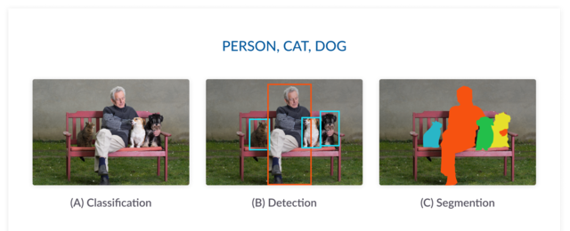
What is image segmentation?
Classification
Categorize images into certain classes
Predict a single label for entire image
Object detection
Detect the objects and their location within an image.
Segmentation
Identify parts of the image and classify what classes they belong to
Pixel-level classification with a set of object classes

Slide 3
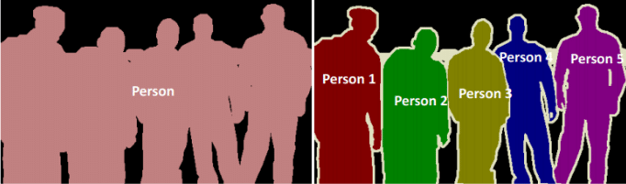
What is image segmentation?
Semantic Segmentation:
Object belongs to same class will have same label
Instance Segmentation:
Segment each instance of each class separately in an image
Detect and delineate each object
Difference:
Semantic segmentation classifies objects of same class as one instance
Instance Segmentation identifies each object as individual instance.
Notes:
How we use image semantic segmentation (digitalbridge.com)

Slide 4
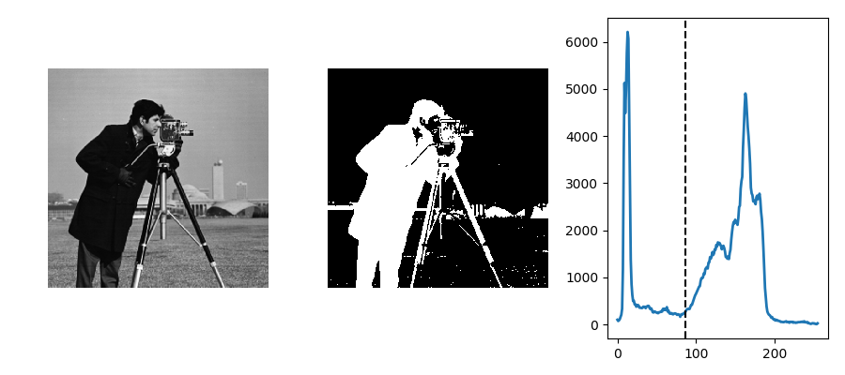
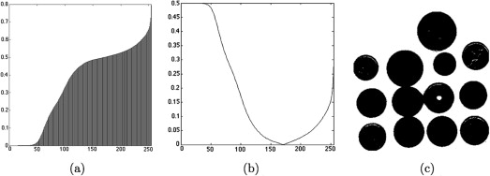
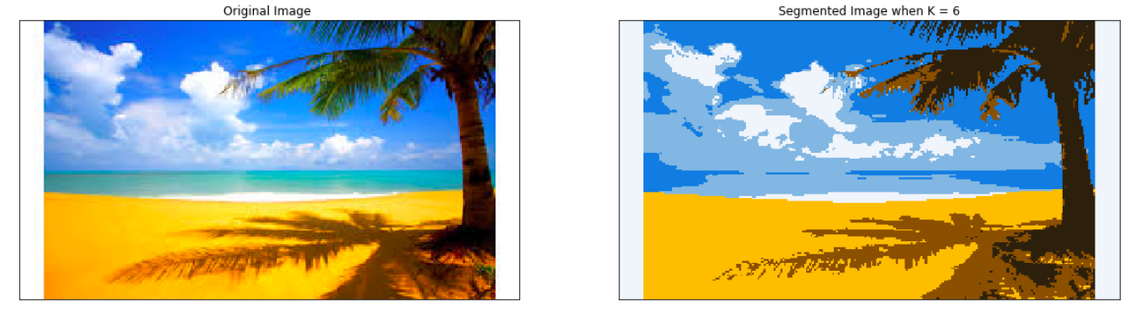
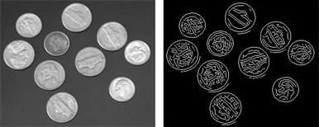
Traditional Methods
Thresholding
Divide an image into different class based on pixel value with threshold.
K-means clustering
Assign each pixel to one of class based on feature similarity
Histogram-based method
Use a histogram to group pixels based on gray levels.
Edge detection
Identify sharp changes or discontinuities in brightness

Slide 5
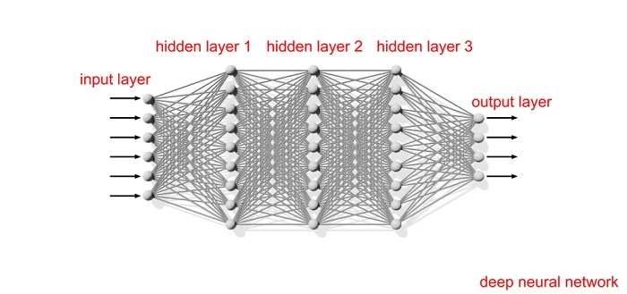
Deep Learning Method
CNN-based method:
Fully convolutional network (FCN)
Encoder-decoder network (Autoencoder)
Generative adversarial networks (GANs)
Recurrent Neural networks (RNNs) + Long short term memory (LSTM)
Transformer network
Notes:
CNN based methods are among the most successful and widely used architectures in the deep learning.

Slide 6

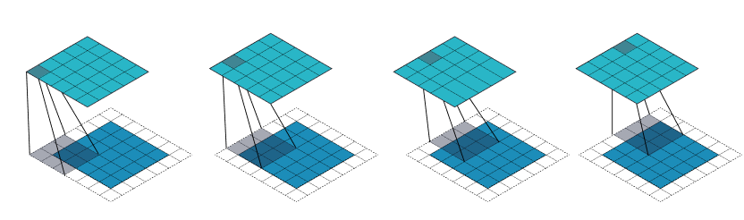
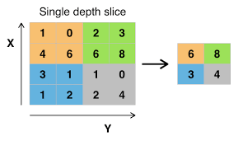
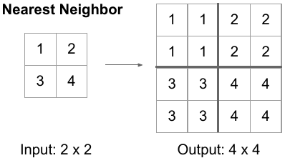
Convolutional Neural Networks (CNN)
Major components:
Fully-connected layer, FC layer (Dense layer)
Each neuron is connected to every neuron in next layer
Convolutional layer
A shared kernel of weights is convolved with input to extract feature maps
Neurons are locally connected and each receives weighted inputs from a small region (receptive field) from previous layer
Sampling layer
Pooling layer (Down-sampling layer)
Replace a small region of feature maps with statistical info (mean, max, etc.)
Reduce the spatial resolution of feature maps
Up-sampling layer / deconvolution layer /un-pooling
Notes:
Convolutional layer:
Since we will have multiple convolutional layers connected to each other, the stacking of kernels increase the final receptive field size in higher level layers and make them learn the features of input from much wider receptive field
Difference between fully-connected layer and dense layer:
A dense layer provides learning features from all combinations of features of the previous layer
A convolutional layer relies on consistent features with a small repetitive field
Why convolutional layer?
All receptive fields in a layer share weights (or using the same kernel) , resulting in a significantly smaller number of parameters than dense layer

Slide 7
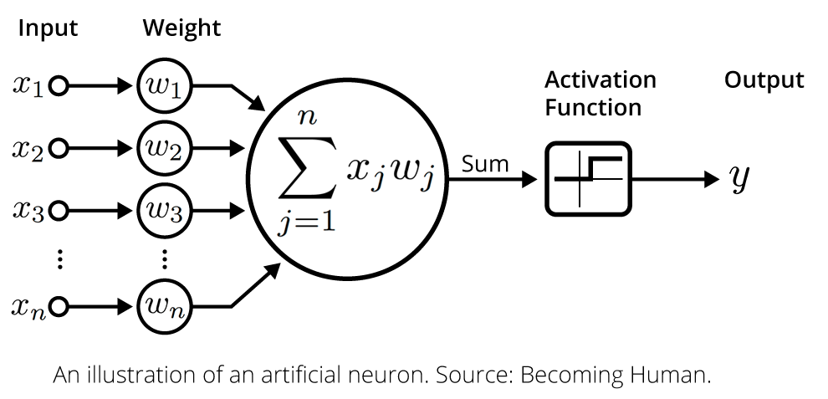
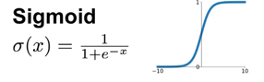
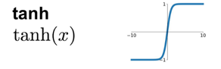
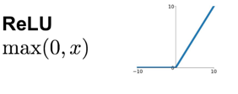
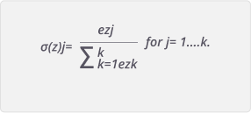
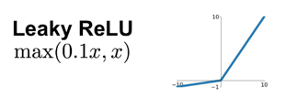
Convolutional Neural Networks (CNN)
Non-linear layer
Apply activation function on feature maps to enable the modelling of non-linear functions
Hidden layer activation
ReLU
Leaky ReLU
Output layer activation
Sigmoid
tanh
Softmax
Softmax
Prediction: [0.8], [0.2], [0.6]
Ground truth: [1 ] ,[0 ], [0 ]
Prediction: [0.7, 0.2, 0.1]
Ground truth: [1 , 0 , 0 ]
Prediction: [0.1, 0.8, 0.1]
Ground truth: [0 , 0 , 1 ]

Slide 8
Deep Learning Method
CNN-based method:
Fully convolutional network (FCN)
Encoder-decoder network (Autoencoder)
Generative adversarial networks (GANs)
Recurrent Neural networks (RNNs) + Long short term memory (LSTM)
Transformer network
Notes:
CNN based methods are among the most successful and widely used architectures in the deep learning.

Slide 9

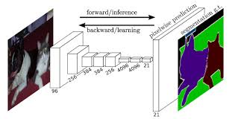

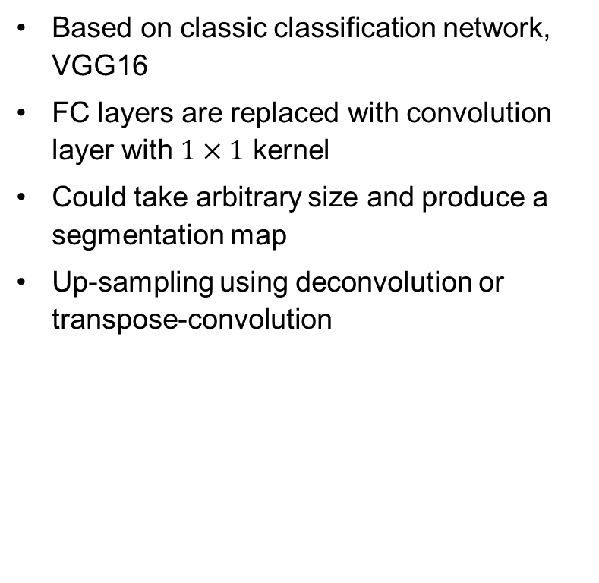
Fully Convolutional Network (FCN)
Based on classic classification network, VGG16
FC layers are replaced with convolution layer with $1×1$ kernel
Could take arbitrary size and produce a segmentation map
Up-sampling using deconvolution or transpose-convolution
VGG16
FCN

Slide 10
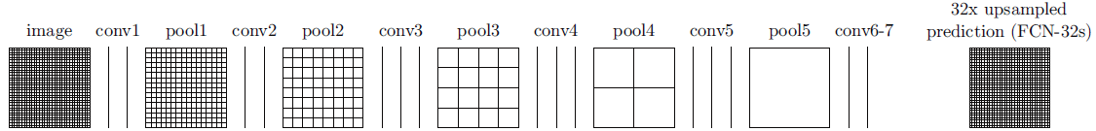
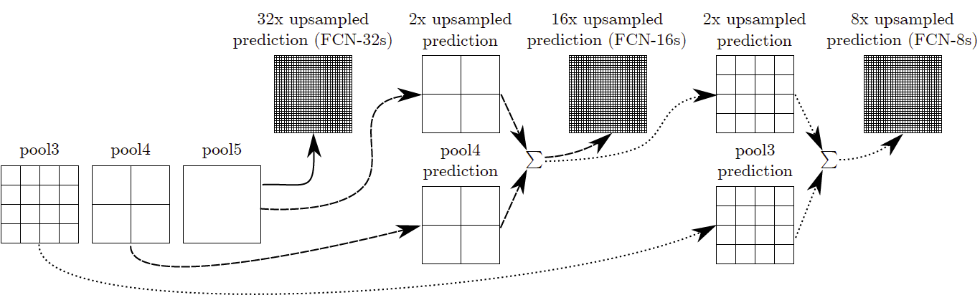
Fully Convolutional Network (FCN)
Output fusion with skip connection:
Local features can be obtained when going deeper, global features or spatial location information is lost when going deeper
Final layers of the model are up-sampled and fused with feature maps of earlier layers
Propagate location information from shallower layers to final segmentation
Con:
Not fast enough for real-time inference
Does not consider global context information (loss of spatial information)
x2
x2
x2
x2
x2
2
4
8
16
32
FCN-32
FCN-16
FCN-8

Slide 11
Deep Learning Method
CNN-based method:
Fully convolutional network (FCN)
Encoder-decoder network (Autoencoder)
Generative adversarial networks (GANs)
Recurrent Neural networks (RNNs) + Long short term memory (LSTM)
Transformer network
Notes:
CNN based methods are among the most successful and widely used architectures in the deep learning.

Slide 12
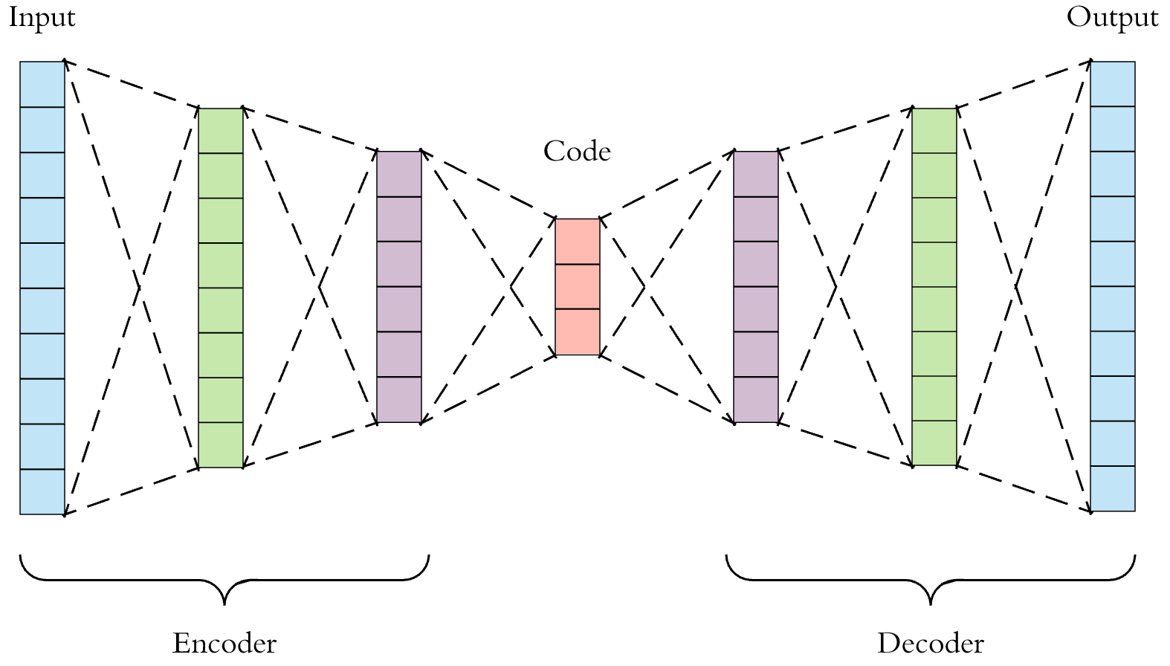
Encoder-Decoder (Autoencoder)
Encoder:
Compress input into a latent-space representation
Latent space:
Capturing the underlying sematic information of the input as feature representation
Decoder:
Predict the output or perform reconstruction from latent space back to original shape
Autoencoder:
Special case of encoder-decoder which input and output are same
Training:
Minimizing the reconstruction loss between the ground truth and output.
Latent Space
Notes:
Encoder-decoder:
Learn to map data-points from an input domain to an output domain via two-stage network

Slide 13
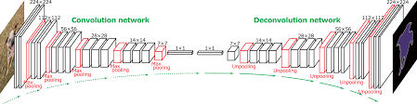
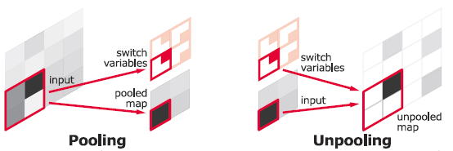
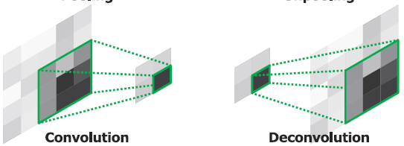
Encoder-Decoder (Autoencoder)
Original VGG16 with FC layer
General Segmentation
DeConvNet (VGG16 extension)
An encoder which uses VGG16 as backbone
An decoder using both deconvolution and un-pooling layers
After deconvolution, the un-pooled feature maps are cropped to keep the identical size
Take the feature vectors as input and generates a pixel-wise class probabilities
Notes:
Unpooling layers:
The position of each maximum value during max-pooling is remember for un-pooling

Slide 14
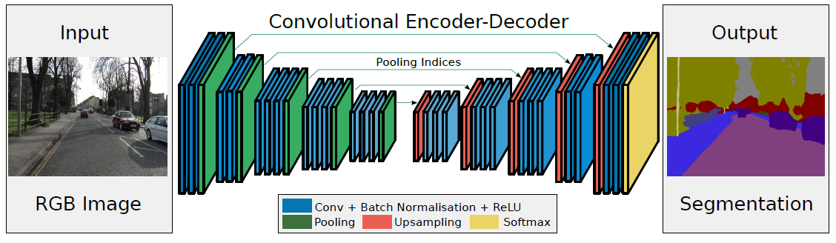
Encoder-Decoder (Autoencoder)
General Segmentation
SegNet
Encoder based on VGG-16 with FC layer discarded (lots of parameters are avoided)
Using un-pooling followed by convolution layer + batch normalisation + ReLu
Use softmax for multi-class segmentation

Slide 15
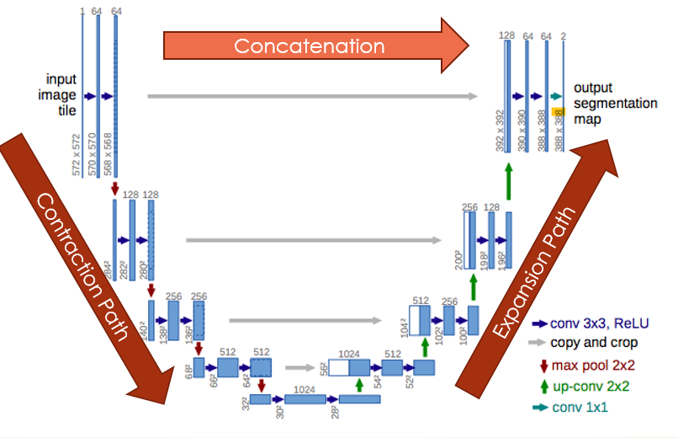
Encoder-Decoder (Autoencoder)
Medical image segmentation
U-Net
Contraction Path (Down-sampling path)
Increase the “What” (Context or Feature information)
Reduce the “Where” (Spatial information)
Expansion Path (Up-sampling path)
Enable precise localization
Regain “where” information for reconstruction
Skip path
Passing local information from contraction path to expansion path
Propagate gradient for better back-propagation
SSkip Path
Notes:
FCN like architerture that extracts features with 3 by 3 convolutions
Talk about different path
Reducing the number of feature maps while increasing their dimensions
Finally, 1 by 1 convolution layer to generate segmentation map using feature maps

Slide 16
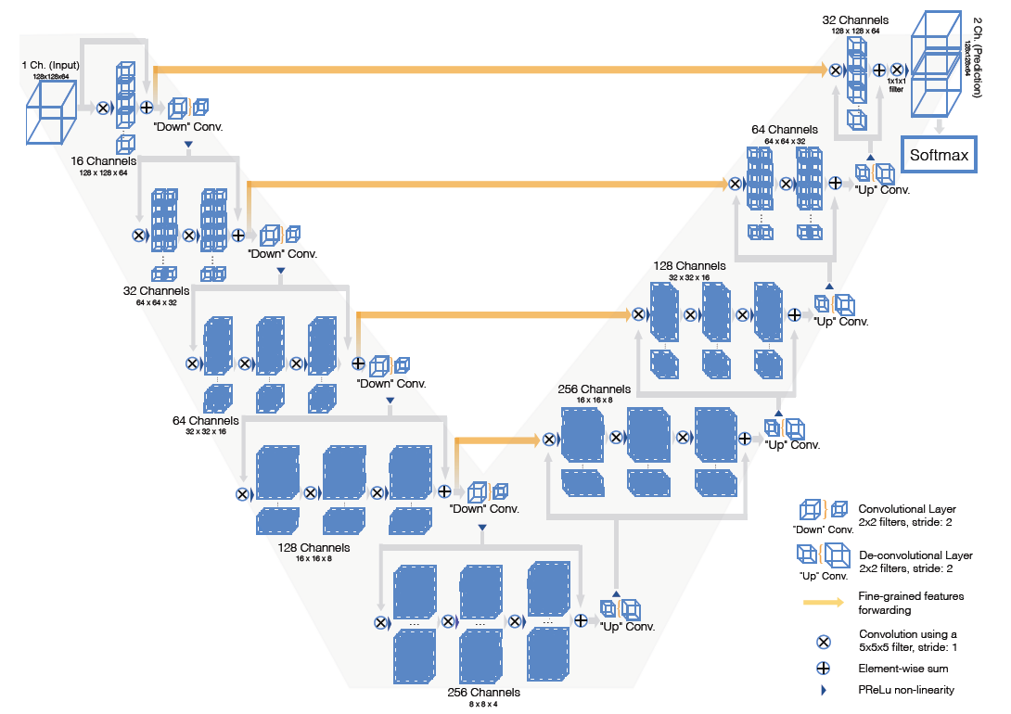
Encoder-Decoder (Autoencoder)
Medical image segmentation
V-Net:
Similar structure to U-Net, but in 3D.
Perform end-to-end segmentation
Encoder:
Residual connection is used to ensure convergence of the training
Convolution with stride of 2 is used for down-sampling
Reduce the memory footprint during training
PReLU is used as activation function
Decoder:
Deconvolution is used for up-sampling
Residual connection is used
Softmax used for multi-class prediction

Slide 17


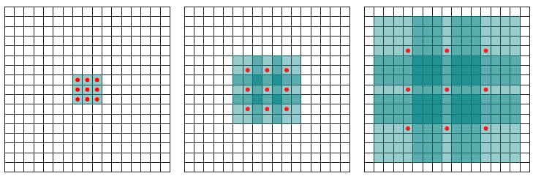
Dilated Convolution (Atrous Convolution)
Problem with autoencoder:
Multiple max-pooling layers are used to increase the receptive field during feature extraction.
Con:
Large number of parameters, thus, large computational cost
Loss of spatial resolution during down-sampling
Solution: Dilated convolution
Effectively enlarge the receptive field by expanding the kernel size with ‘holes’
Capture larger context without increasing the number of parameters
No down-sampling needed and faster computation with less parameters
Notes:
Con:
Up-sampling is needed to reconstruct images which introduce large the number of parameters, thus, increase computational cost
Spatial resolution of the resulting feature map are reduced significantly, which leads to poor prediction on multi-scale objects and uncertainty near object boundaries

Slide 18
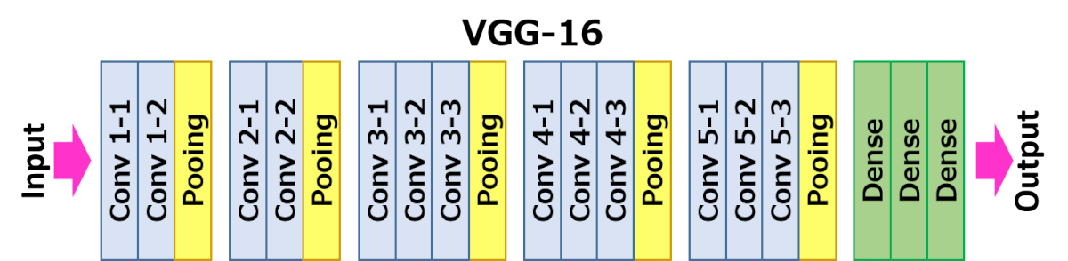
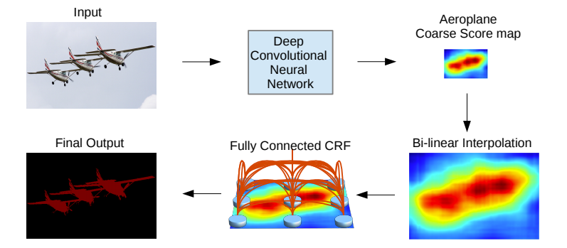
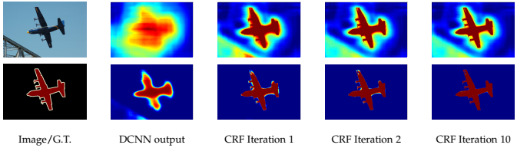
Dilated Convolution Network
DeepLabV1
Structure
Based on VGG-16
The stride of last pooling layer and conv 5-1 set to 1
All convolution layers within 5th block replaced with dilated convolution layer using rate = 2
Features:
Avoid feature resolution reduction using dilated convolution
Post-process using fully connected Conditional Random Field (CRF) to the capture edge details and iteratively refine the prediction.
Con:
Fail to segment objects at multiple scales
Notes:
What is cfr?
1. Conditional Random Field (CRF) is a graphical model where nodes are locally connected. It calculates the output probabilities at each node given neighborhood information w.r.t. some predefined energy function
2. Local approximation - only information at adjacent nodes is taken into consideration
3. DCNN’s outputs probability vectors at each pixel, then CRF refines the output
What does CRF do?
The CRF potentials incorporate smoothness terms that maximize label agreement between similar pixels, and can integrate more elaborate terms that model contextual relationships between object classes

Slide 19
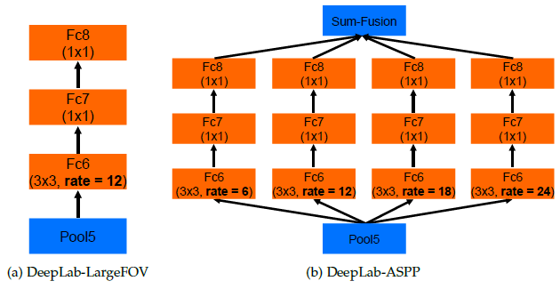
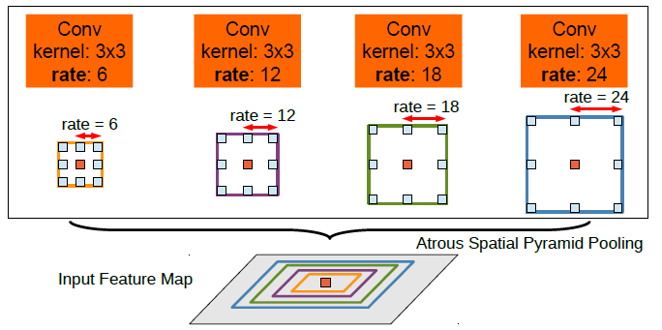
Dilated Convolution Network
DeepLabV2
Atrous Spatial Pyramid Pooling (ASPP)
Parallel dilated convolution with different sampling rates to the input feature map and fuse together at end

Slide 20
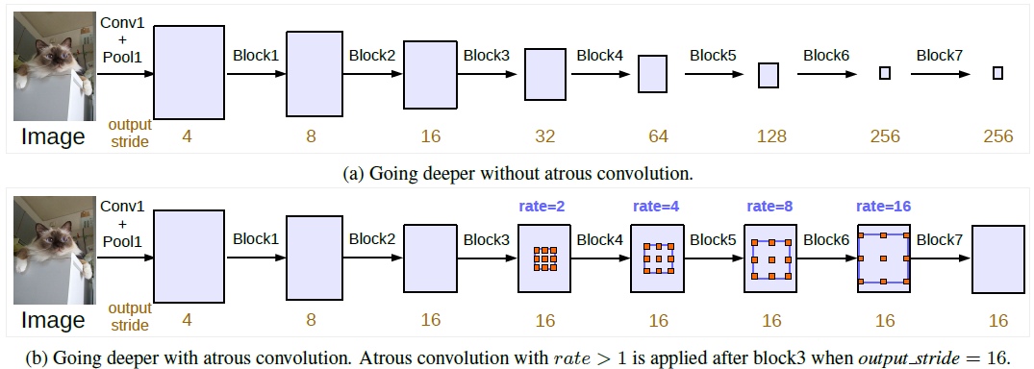
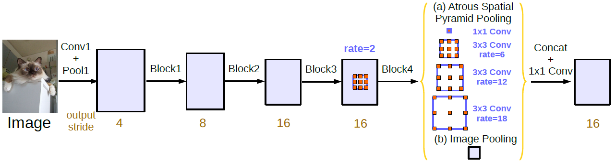
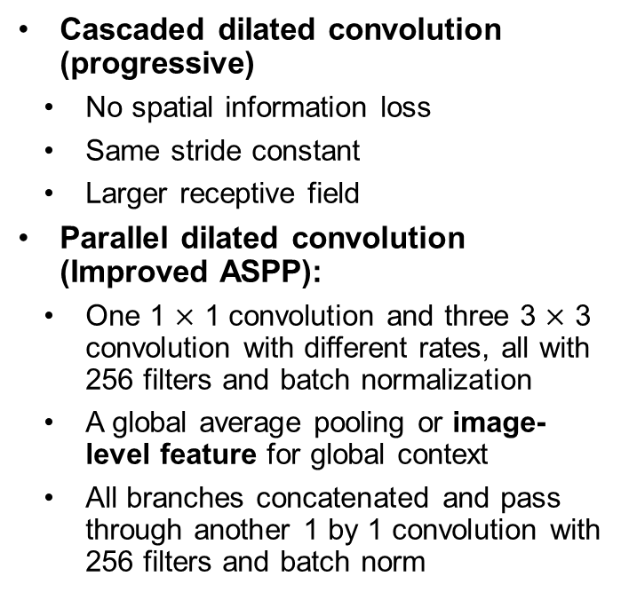
Dilated Convolution Network
DeeplabV3
Cascaded dilated convolution (progressive)
No spatial information loss
Same stride constant
Larger receptive field
Parallel dilated convolution (Improved ASPP):
One 1 $×$ 1 convolution and three 3 $×$ 3 convolution with different rates, all with 256 filters and batch normalization
A global average pooling or image-level feature for global context
All branches concatenated and pass through another 1 by 1 convolution with 256 filters and batch norm
Notes:
Standard conv and pooling are performed which makes the output stride increasing, i.e. the output feature map smaller, when going deeper.
However, consecutive striding is harmful for semantic segmentation because location/spatial information is lost at the deeper layers.
With atrous conv, we can keep the stride constant fixed but with larger receptive field without increasing the number of parameters or the amount of computation.
Original problem for ASPP”
1. as the sampling rate becomes larger, the number of valid filter weights (i.e., the weights that are applied to the valid feature region, instead of padded zeros) becomes smaller. Eg. We have a image with size of 60 by 60 and a filter with size of 3 by 3. if the dilated rate is close the image size, only the middle weight within the filter still cover the valid image, rest will be padded zeros.

Slide 21
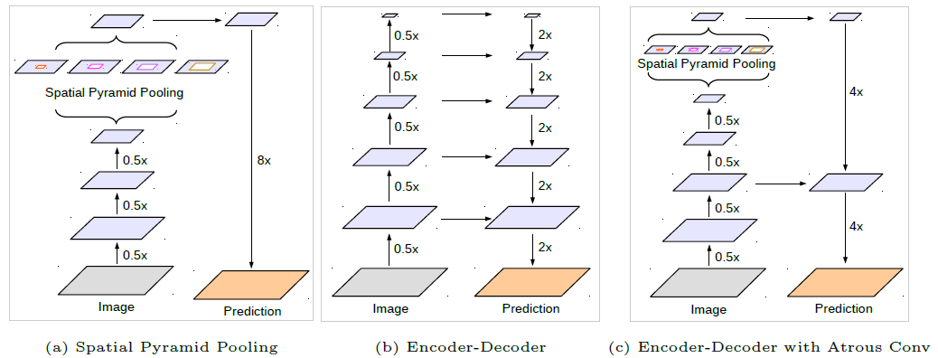
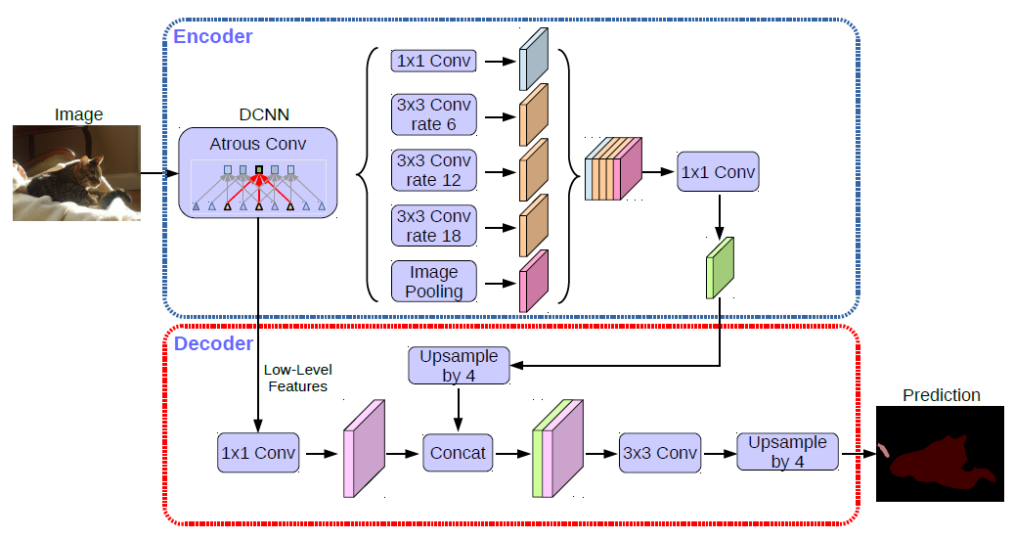
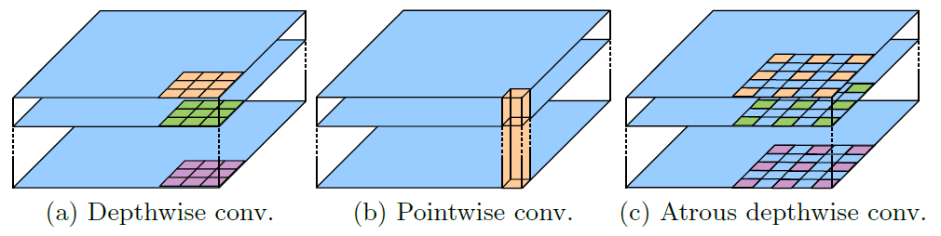
Dilated Convolution Network
DeeplabV3+
Atrous Separable Convolution
Atrous convolution +Depthwise convolution + Point-wise convolution
Further reduce complexity while maintaining similar performance
Encoder-Decoder Architecture
DeeplabV3 as encoder
A simple Decoder
Notes:
depthwise convolution performs a spatial convolution independently for each input channel
pointwise convolution is employed to combine the output from the depthwise convolution

Slide 22
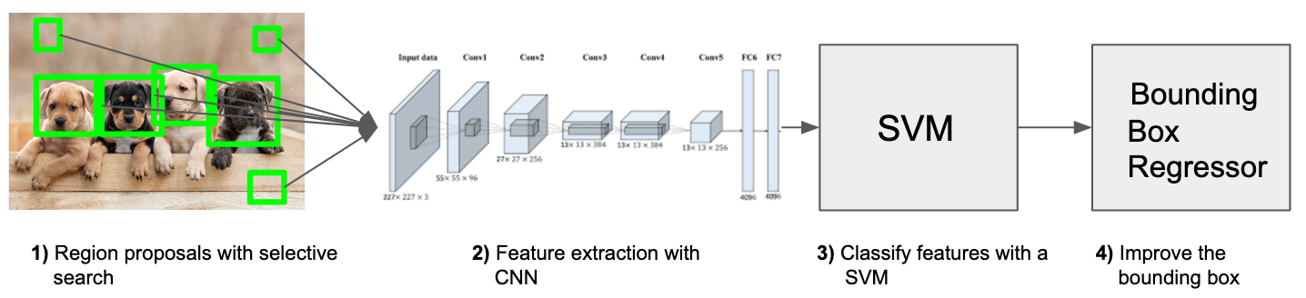
Instance Segmentation
R-CNN
Con:
Slow computation. Need to calculate feature map for each region proposal
Hard to train. Three different parts which need to be trained seperatelly
Huge memory consumption. Storage of all feature vectors for all region proposal
Notes:
Use region proposal with selective search to generate 2000 different sub-regions from input image
Use CNN such as AlexNet to create a feature vector representing each region separately. CNN is normally pretrained
Remove the final softmax activation, so the network produce a vector after FC layer
Train one SVM for each class and use them to classify which class that feature vector belongs to
Use non-maximum suppression to reduce the number of the proposal. How? We reject an image proposal if it has an hige IoU overlap with a a proposal with higher score calculated by SVM.
Use bounding box regressor to improve the precision of bounding box or the selected image proposal (centre, height, width of region proposal as input, groud truth bounding box as label)

Slide 23
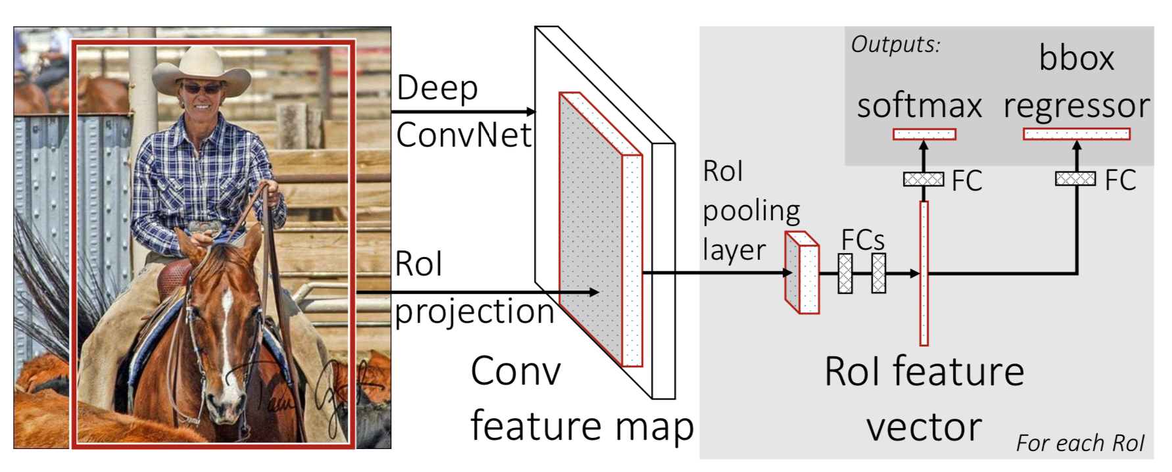
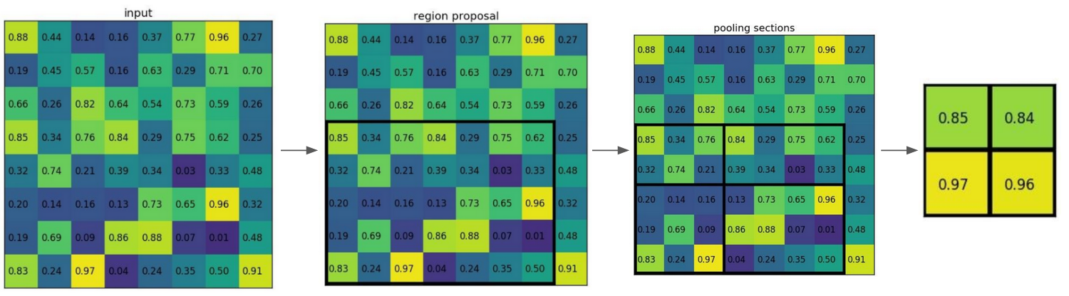
Instance Segmentation
Fast R-CNN
Combine all CNN, SVM and bounding box regressor into single system.
ConvNet -> generate feature map for whole image
Project region proposal (from selective search) into feature map and extract region proposal (RP) feature map
RoI pooling layer -> resize each RP feature map into fix size
Flatten each fixed-size RP feature map and get feature vector
FC layers with 2 outputs:
Softmax for object classification
Bbox regressor to output box coordinates for each object
Notes:
Project region proposal (selective search) into feature map and extract feature map for each region proposal.
Then resize each region feature map into fix size

Slide 24
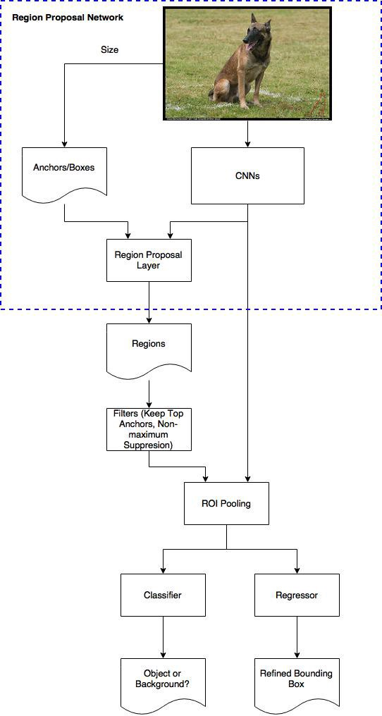
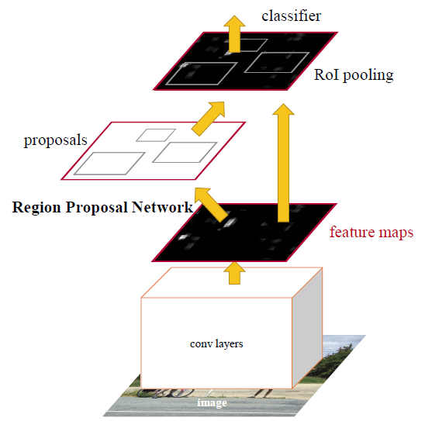
Instance Segmentation
Faster R-CNN
No need for region proposal with selective search
Use a network called Region Proposal Network (RPN) on generated feature maps to automatically generate possible bounding box.
ROI pooling layer for computing features and fixed size
Notes:
Region Proposal Network — A detailed view | by Sambasivarao. K | Towards Data Science

Slide 25
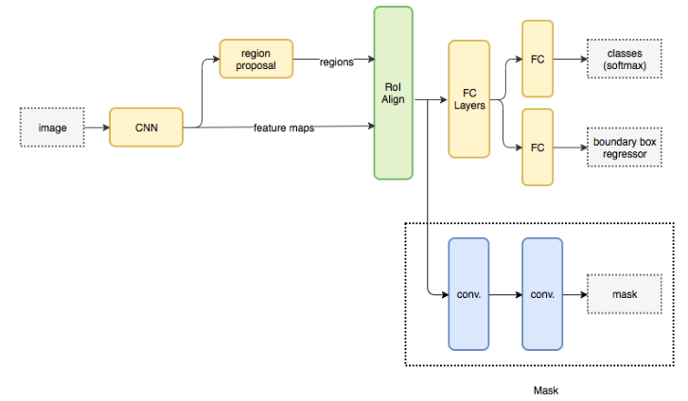
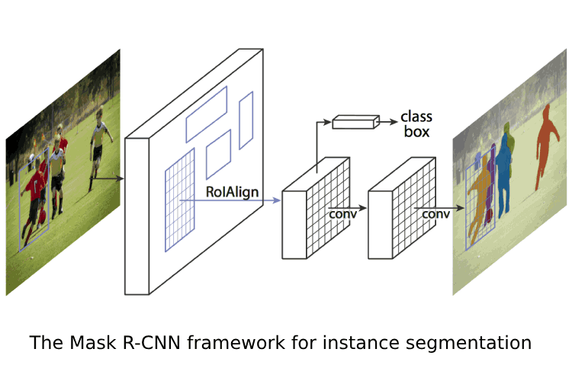
Instance Segmentation
Mask R-CNN
A Faster R-CNN with 3 output branches:
Bounding box regressor for bounding box coordinates
Classification to compute the classes
Binary mask to segment object
Losses from all branches are combined as loss function

Slide 26
Network Training process
https://theffork.com/activation-functions-in-neural-networks/
Stage 1: Data preparation
Data Loading
Data Pre-processing
Stage 2: Training Stage
Building the model
Compile the model
Train the model
Model evaluation
Model Prediction
Stage 3: Testing Stage
Performance Evaluation
Stage 4: Evaluation
#deep-learning-uq

Slide 27
Data preparation: Data loading
Traditional method (fully customizable):
Load the all filenames into list
Load each data into np.array using its filename
Combine all data array into single array or using iterative (generator)
os.listdir()
glob.glob()
From pillow import Image
Image = Image.open(“filename”)
Tensorflow built-in methods:
Built-in data library (easy, no customize)
Only has common datasets
E.g. tf.keras.datasets.mnist.load_data()
tf.keras.preprocessing.image_dataset_from_directory() (medium, limited customize)
only works for tf_version = 2.3.0
limited image formats: jpeg, png, bmp, gif
tf.data.Dataset: (hard, fully customize)
Dataset = tf.data.Dataset.list_files(“filename_pattern”)
Dataset.map(lambda_function_for_image_reading)
#deep-learning-uq
Notes:
Tf.data.dataset is a API which used to create a source dataset from your input data

Slide 28
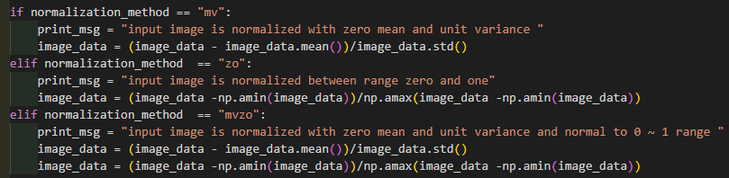
Data preparation: Data pre-processing
Why do we need pre-processing?
messy and from different sources
Standardize and clean up
Reduce complexity and increase performance
Techniques:
Reduce complexity
Convert to grey scale
Standardize images
Clip
Crop
Normalization
Change data structure for specific task
One-hot encoding
Training set
Overall Dataset
Validation set
Testing set
#deep-learning-uq

Slide 29
Network Training process
https://theffork.com/activation-functions-in-neural-networks/
Stage 1: Data preparation
Data Loading
Data Pre-processing
Stage 2: Training Stage
Building the model
Compile the model
Train the model
Model evaluation
Model Prediction
Stage 3: Testing Stage
Performance Evaluation
Stage 4: Evaluation
#deep-learning-uq

Slide 30
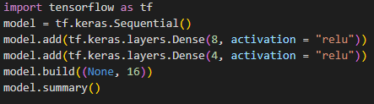
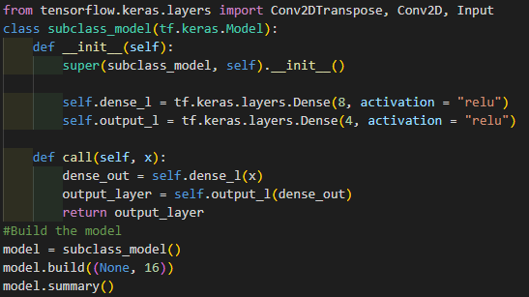
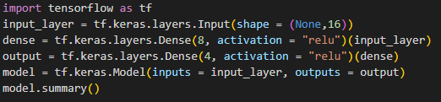
Training Stage: Build the model
Head
Body 1
Body 2
Tail
Building method:
Sequential Method (easy):
…….
Model Subclassing(hard):
Functional API (medium):
#deep-learning-uq

Slide 31

Training Stage: Build the model
Common Layers:
Input layer:
SHAPE is important
Let’s say we have a input set with shape of (Number of images, h, w)
The input needs to be a 4D tensor when using 2D operation (CONV2D) or 5D tensor when using 3D operation (CONV3D)
tf.keras.Input(shape = (h, w, channel_number))
Correspond to number of images:
How many images will be fed at same time during training
(None, h, w, channel_number)
Output Image
Output Image
Output Image
Input Image
Input Image
Output Image
Filter
Output Image
Filter
Output Image
Filter
=
CONV2D
Filter
Filter
Filter
(32,32)
(32,32,1)
(3,3,32)
(32,32,32)
#deep-learning-uq

Slide 32

Convolution Neural Networks in Tensorflow
Dense layer (Fully-connected layer)
tf.keras.layers.Dense(units, activation, kernel_initialize, activity_regularizer, …)
Convolutional layer
tf.keras.layers.Conv2D(filters, kernel_size, strides, padding, activation, kernel_initialize, activity_regularizer, …)
Pooling layer
tf.keras.layers.MaxPool2D(pool_size, strides, padding)
Up-sampling layer
tf.keras.layers.UpSampling2D(size, interpolation)

Slide 33
Network Training process
https://theffork.com/activation-functions-in-neural-networks/
Stage 1: Data preparation
Data Loading
Data Pre-processing
Stage 2: Training Stage
Building the model
Compile the model
Train the model
Model evaluation
Model Prediction
Stage 3: Testing Stage
Performance Evaluation
Stage 4: Evaluation
#deep-learning-uq

Slide 34

Training Stage: Compile the model
Optimizer:
Gradient Descent:
Depends on first order derivative of a loss function
Calculates which way the weights should alter to reach minima
Stochastic Gradient Descent (“SGD”)
A variant of Gradient Descent, which update parameters more frequently
Momentum:
Gradient Descent with momentum term
Reducing high variance in SGD and softens the convergence
Root Mean Square Propagation(“rmsprop”)
Gradient descent with momentum
Weights updating in vertical direction is restricted, so we could increase learning rate and the algorithm could take larger step
Adaptive Moment Estimation (“Adam”):
works with momentums of first and second order
#deep-learning-uq
Notes:
Optimizer are algorithm or methods which used to change the attributes of your neural network such as weights and learning rate in order to reduce the losses
Gradient Descent:
1. Most basic optimizer
Advantages:
Easy computation.
Easy to implement.
Easy to understand.
Disadvantages:
May trap at local minima.
Weights are changed after calculating gradient on the whole dataset. So, if the dataset is too large than this may take years to converge to the minima.
Requires large memory to calculate gradient on the whole dataset.
SGD:
Advantages:
Frequent updates of model parameters hence, converges in less time.
Requires less memory as no need to store values of loss functions.
Disadvantages:
High variance in model parameters.
May shoot even after achieving global minima.
Momentum:
1. accelerates the convergence towards the relevant direction and reduces the fluctuation to the irrelevant direction
Advantages:
Reduces the oscillations and high variance of the parameters.
Converges faster than gradient descent.
Disadvantages:
One more hyper-parameter is added which needs to be selected manually and accurately.
Adam
we don’t want to roll so fast just because we can jump over the minimum, we want to decrease the velocity a little bit for a careful search
Advantages:
The method is too fast and converges rapidly.
Rectifies vanishing learning rate, high variance.
Disadvantages:
Computationally costly.

Slide 35


Training Stage: Compile the model
Loss:
Mean squared error (“mse”)
Evaluate the similarity between input and output
$L_{mse}=E{\left|\left|G\left(x\right)−y\right|\right|}^{2}$
CrossEntropy”:
$CE=−\sum_{i}^{C}{t_{i}log⁡(s_{i})}$
Binary CrossEntropy (“binary_crossentropy”)
Binary classes
Sigmoid + crossentropy
$CE=−\sum_{i=1}^{C=2}{t_{i}\log\left(s_{i}\right)}=−t_{1}\log\left(s_{1}\right)−\left(1−t_{1}\right)\log\left(1−s_{1}\right)$
Categorical CrossEntropy (“categorical_crossentropy”)
Multiple classes
Softmax + crossentropy
$CE=−\sum_{i}^{C}{t_{i}log⁡(f{\left(s\right)}_{i})}$ , $f{\left(s\right)}_{i}=\frac{e^{s_{i}}}{\sum_{i}^{c}{e^{s_{j}}}}$
Special case for one-hot encoding
$t_{i}=1$ only for positive class, other classes will be zero
#deep-learning-uq

Slide 36




Training Stage: Compile the model
Loss:
Dice similarity coefficient (custom loss)
It gauges the similarity of segmented and manual delineated images based on their overlap measurement
$S_{DSC}=\frac{2\sum_{i∈I}{P_{i}Q_{i}}}{\sum_{i∈I}{P_{i}+\sum_{i∈I}{Q_{i}}} }$
#deep-learning-uq

Slide 37
Network Training process
https://theffork.com/activation-functions-in-neural-networks/
Stage 1: Data preparation
Data Loading
Data Pre-processing
Stage 2: Training Stage
Building the model
Compile the model
Train the model
Model evaluation
Model Prediction
Stage 3: Testing Stage
Performance Evaluation
Stage 4: Evaluation
#deep-learning-uq

Slide 38



Training Stage: Train the model
Tensorboard
Model.fit()
Model Training:
Model.fit() (easy, not customizable)
Batch_size
Epochs
Validation_split
Callbacks
Actions which can be performed at various stages of training
ModelCheckpoint
Tensorboard
tf.GradientTape() (hard, fully customizable)
ModelCheckpoint
#deep-learning-uq

Slide 39
Network Training process
https://theffork.com/activation-functions-in-neural-networks/
Stage 1: Data preparation
Data Loading
Data Pre-processing
Stage 2: Training Stage
Building the model
Compile the model
Train the model
Model evaluation
Model Prediction
Stage 3: Testing Stage
Performance Evaluation
Stage 4: Evaluation
#deep-learning-uq

Slide 40

Testing Stage: Model prediction
#deep-learning-uq

